Slide 1
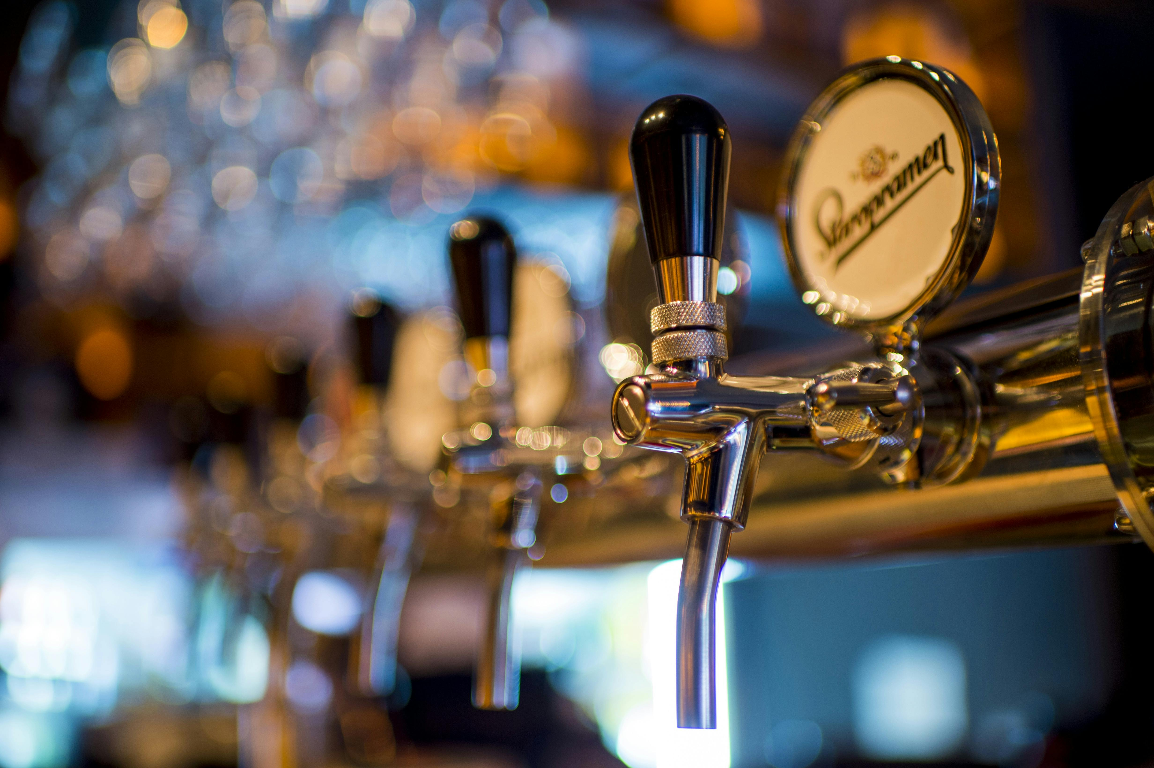
Breweries In USA
Breweries In the USA
Analysis

Slide 2
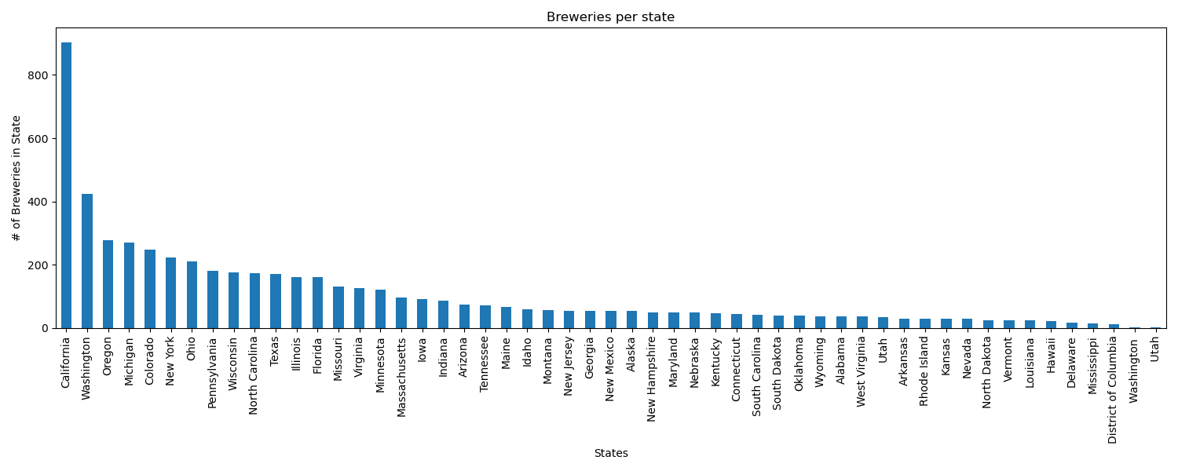
Number of Breweries per State
Looking at the data, there were more breweries, and brewery types, then originally thought by myself. We brought in over 8000 per openbrewerydb and then removed all other countries bringing the total to 5736. Some of the data didn't have Lat/long so those were removed to bring the dataset to 5524 breweries. California leaded the most with this dataset with 904 with second being Washington at 423.

Slide 3
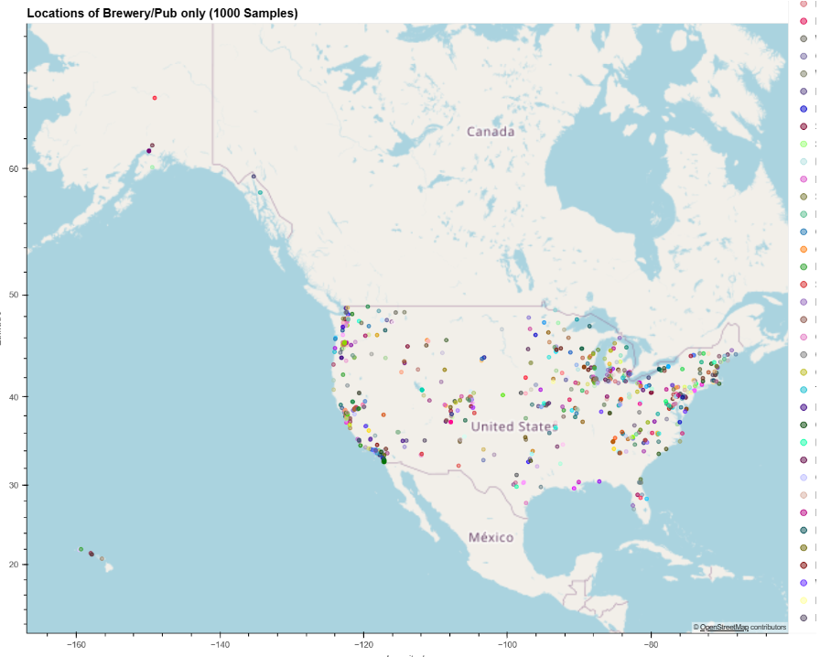
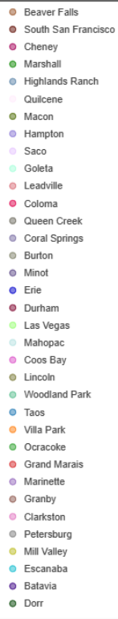
Number of Breweries per State
When the data was mapped, it appears that majority of the breweries are near a body of water. Either being on a coast or near a large lake body. Import/Exports would have been the next step to look for and compare with ports and brewery locations, but unable to find necessary data in timeframe.

Slide 4
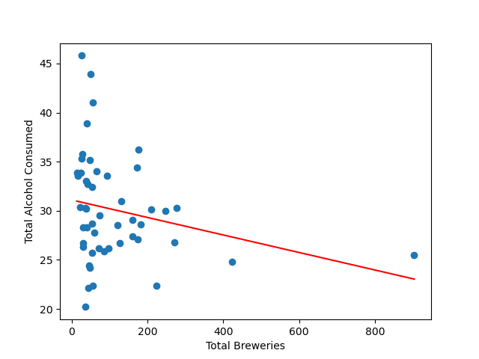
Consumption Rate to Number of Breweries
Generating a basic scatter plot, we can see that our plot is pretty bundled together indicating little to no correlation. Plotting our line and printing our R Value, the scatter plot has an actual negative correlation between our two values, sitting at -.24.
This means the states with most breweries are states that are drinking the least. This at the very least indicates that the # of Breweries Per State is driven by a separate factor.

Slide 5
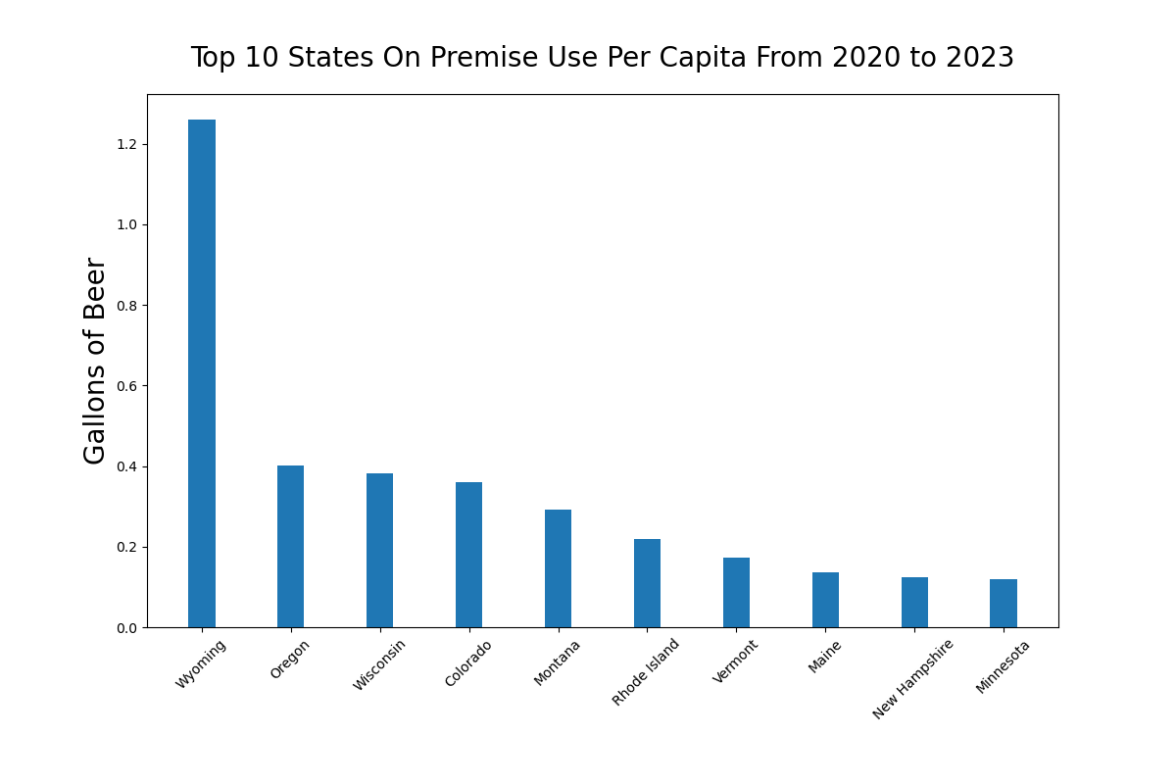
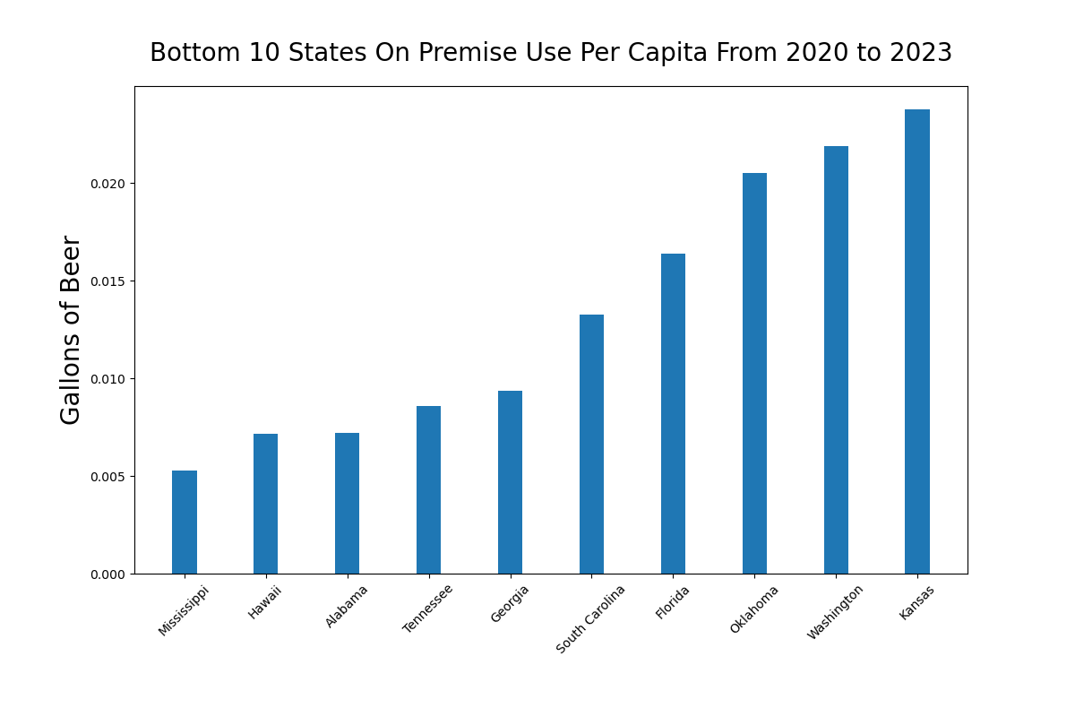
Which state paid the most taxes for premise use?
The state with the highest on-premise use taxes per capita was Wyoming.
The state with the lowest on-premise use taxes per capita was Mississippi.
In 2023 the state with the highest beer tax is Tennessee at $1.29 per gallon. The state with the lowest beer tax is Wyoming at a rate of $0.02 per gallon. Ref: https://taxfoundation.org/
Beer taxes are known as an excise tax. This is sometimes referred to as a ‘sin’ tax. Each state has its own set of rules for excise taxes.
Most states have only an excise tax, but some states also include an Ad Valorem (A Latin phrase meaning “according to the value.”).
Ad Valorem applies to other factors such as alcohol %.
Note that the taxes paid on premise does not directly correlate with consumption rate per capita as there are other factors that effect the amount of taxes owed.

Slide 6
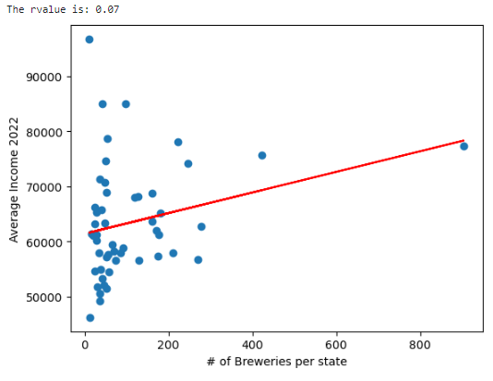
Average Income to Number of Breweries
We had an initial question of average income per state with breweries and if there was a correlation. After bringing in the income and merging the files, the data was placed onto a scatter plot. The correlation was a .07 and the graph indicated there was no correlation.

Slide 7
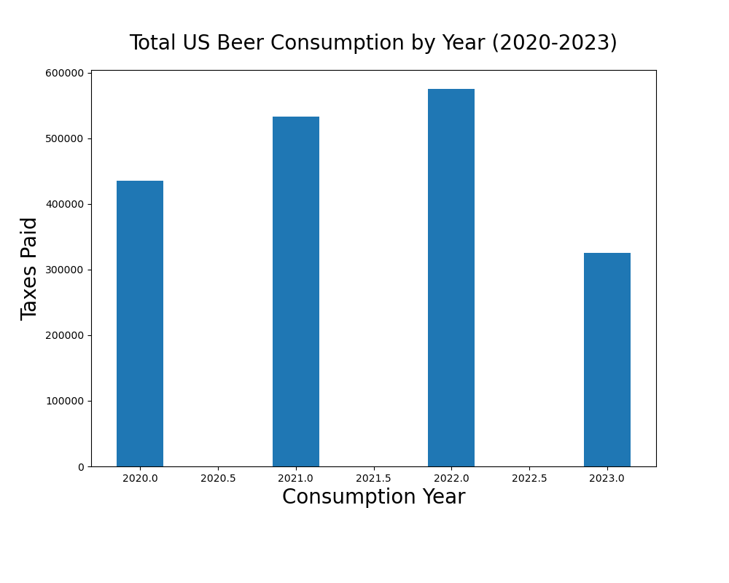
Is Beer Consumption Rising or Falling?
The consumption rate is rising steadily between the years of 2020 to 2023.
The highest rate so far is in 2022, but the 2023 data is missing the 4th quarter information.
While 2023 has the lowest consumption rate, I would estimate that after all information has been reported for 2023, the consumption rate will be greater than 2022.
The possible reason for increased consumption may be due to lifestyle changes that have occurred in recent years. It’s possible that we are returning to a consumption rate that matches previous years not included in this report.
Beer production is measured in barrels. There are 31 gallons of beer in a barrel. An average monkey weighs 22.5 lbs. A gallon of beer weighs about 8.34 pounds This means you can fit about 11.5 monkeys in a barrel 😊

Slide 8
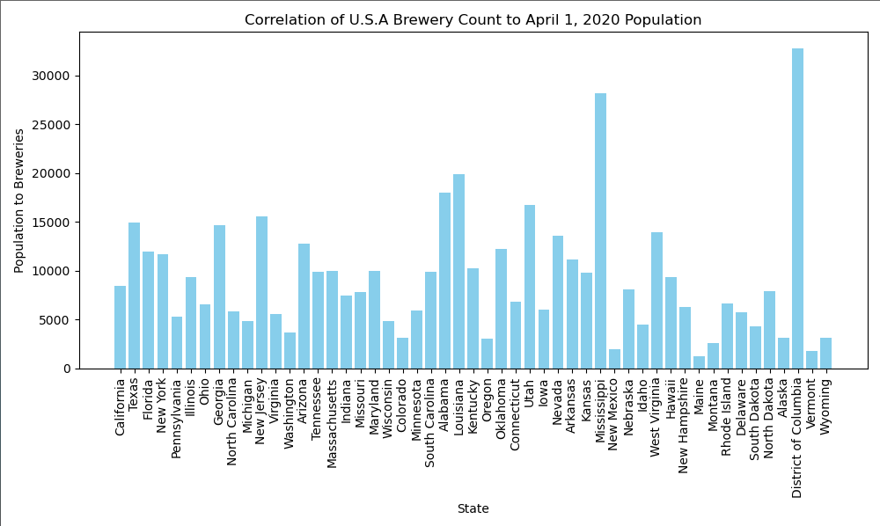
State Population to Number of Breweries
The Top 10 most populated states are all located by a major body of water. Of those 10 only 4 have a population to brewery ratio over 10,000:1.
The State with highest population to brewery ratio is Wyoming with a ratio around 32,835 citizens for every 1 brewery.
The State with the Lowest population to brewery ratio is Alabama with a ratio around 1,279 citizens for every 1 brewery.

Slide 9
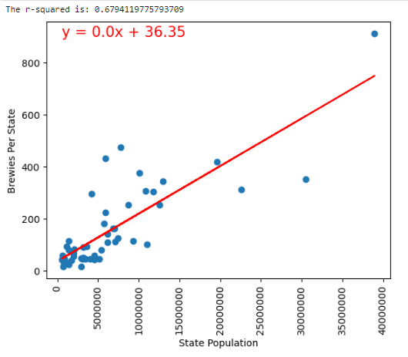
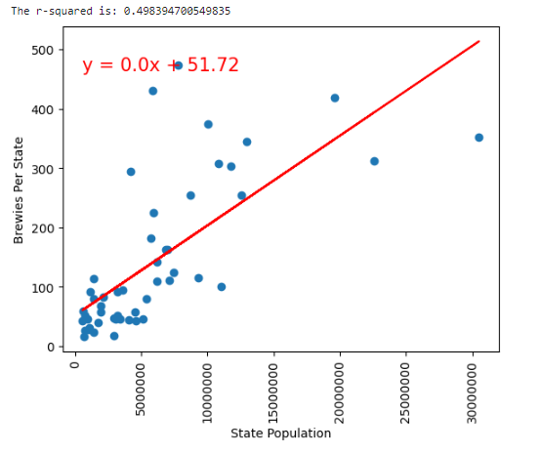
Population to Breweries Correlation
With all the states and territories there is a moderate correlation between the state population to the number of breweries with the r value equaling about .68
California is an outlier with 904 Breweries to the population when we remove it the r value becomes about .50

Slide 10
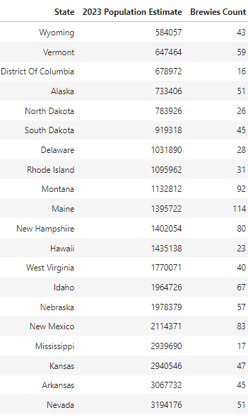
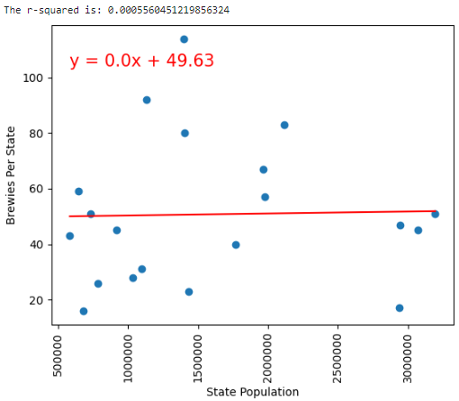
Population to Breweries Correlation
If we did just the 20 smallest states there would be no correlation even with the 114 breweries in Maine. Even Nevada with its population the brewery count is 51.

Slide 11

Issues That Came up
Issue 1

